Slide 1

Clarification for MTN Group Infrastructure RFP
October 2020

Slide 2
Company Overview
Project Scope and Huawei Understandings
Huawei Technical Solutions
Huawei Infrastructure Services
Notes:
标题
改为Project Scope and Huawei Understanding
Huawei Solution改为What Huawei could do

Slide 3



Huawei: Leading Provider of ICT Infrastructure & Services
Bring digital services to every person, home and organizations for a fully connected, intelligent world
Annual Revenue (US$ bn)
Revenue Growth
105.2
122.97
92.5
H1 2020
64.24B USD
13.1%
75.1
Year 2019
122.97B USD
16.9%
61.3
46.7
Revenue
Revenue
Global Reach and Coverage
2014
2015
2016
2017
2018
2019
85,000+ Patents
held by Huawei as of December 31, 2019
15,000+ Employees
engaged in fundamental researches
194,000
Employees
96,000+
R&D employees
170+
Countries and regions
61
on Global 500

Slide 4
Company Overview
Project Scope and Huawei Understanding
Huawei Technical Solution
Huawei Infrastructure Service
Notes:
标题
改为Project Scope and Huawei Understanding
Huawei Solution改为What Huawei could do

Slide 5

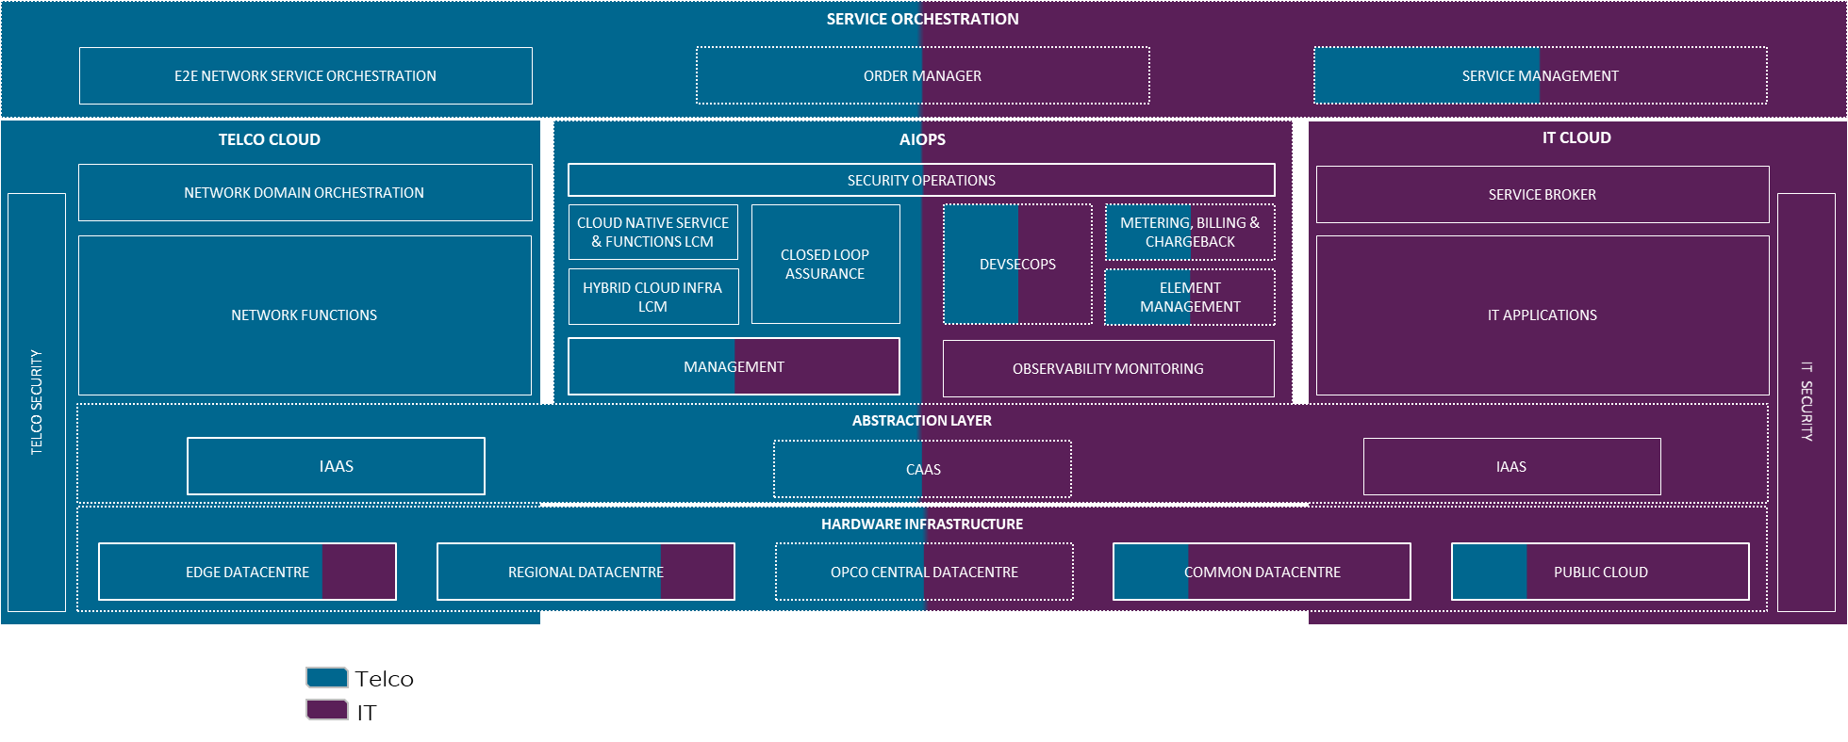
MTN Strategy Understanding
MUNIC
Business
Strategy
SERVICE AGILITY
INNOVATION & DIFFERENTIATION
CAPITAL EFFICIENCY
OPERATIONAL EFFICIENCY
Architecture
Standardization to support both IT and CT business needs
Future-proof for continuous evolution of Telco 5G and Digital Business
Open and flexible to leverage broad creation and innovations
High Reliability and Scalability to suite explosive data growth and ensure business continuity
Infrastructure
Requirement

Slide 6
Scope of MTN Infrastructure RFP
Rack Server
Blade Server
Server
Service
Design, supply, build, implementation, support and transfer of knowledge of the required technology infrastructure
Infrastructure
Converged
Infrastructure
Storage
HCI
CI
Native All Flash Storage
Traditional Hybrid Storage

Slide 7
Company Overview
Project Scope and Huawei Understanding
Huawei Technical Solution
Huawei Infrastructure Overview
Server
Storage
HCI&CI
Huawei Infrastructure Service
Notes:
标题
改为Project Scope and Huawei Understanding
Huawei Solution改为What Huawei could do

Slide 8

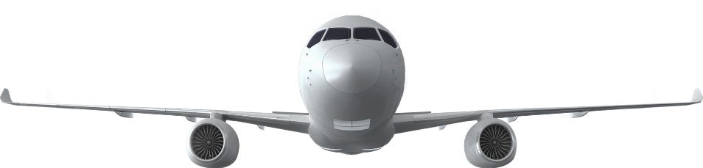
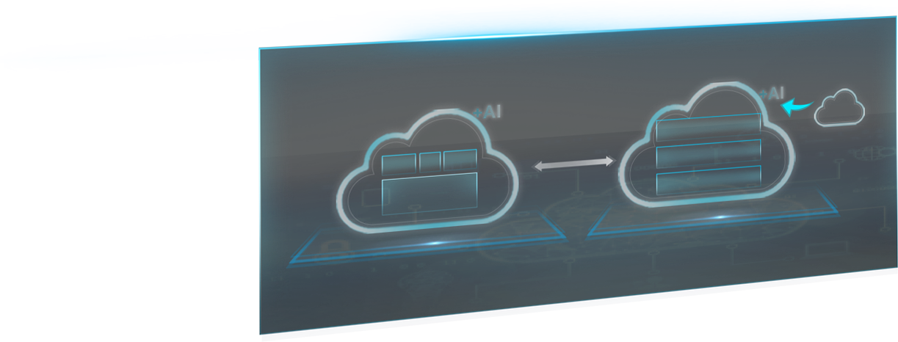
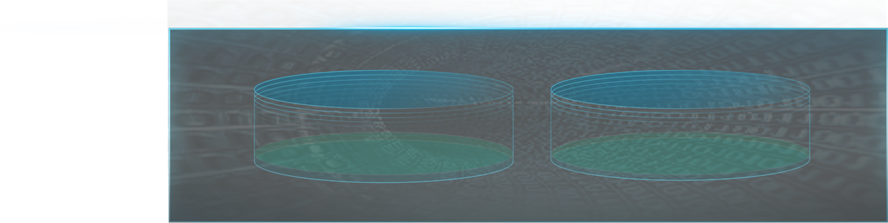
Huawei’s Strategy to build new ICT Infrastructure
1 Cloud, 2 Wings, 2 Engines, plus an Open Ecosystem
Open ecosystem
Open hardware | Open source software | Partner enablement
HUAWEI CLOUD
Basic | EI | Applications
Computing
Data Storage and Intelligent Vision
General purpose | AI | Edge
Data storage | Intelligent vision | Intelligent collaboration
General computing power
Kunpeng + x86
AI computing power
Ascend + GPU
Workloads-driven Diversified Computing
Data-driven Unified Data Infra.
Service-driven Cloud-AI Alignment
Kunpeng + Ascend + X86
All Flash + Distributed storage
5G + Cloud + AI
AI Server
AI Cluster
Central
Atlas 900
Taishan 2280
Atlas 800
Converged Storage Pool
Intelligent Data Lake
APP Eco
AI accelerator module
CDN
AI
AI
Edge
AI edge station
MEC
PaaS
Atlas 200
Architecture | Performance & Reliability | Data Density | Data Value
Diversified
Computing
PaaS
Taishan 2280E
Atlas 500
5X Mgmt. Efficiency
20M IOPS , 99.99999%
2400TB / 5U
5X Data Utilization
ARM computing
AI Computing
Hybrid Cloud
Edge Cloud
Best-suited IT Architecture
Notes:
KM:
1.华为具有从芯片到infra到云的立体能力
2.完整的产品生态

Slide 9










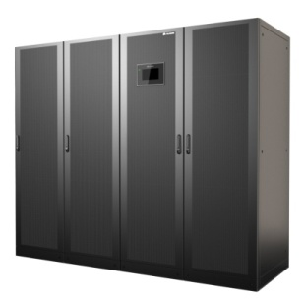
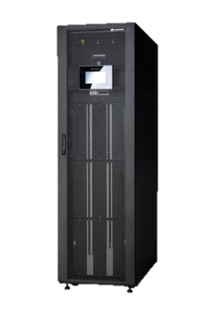
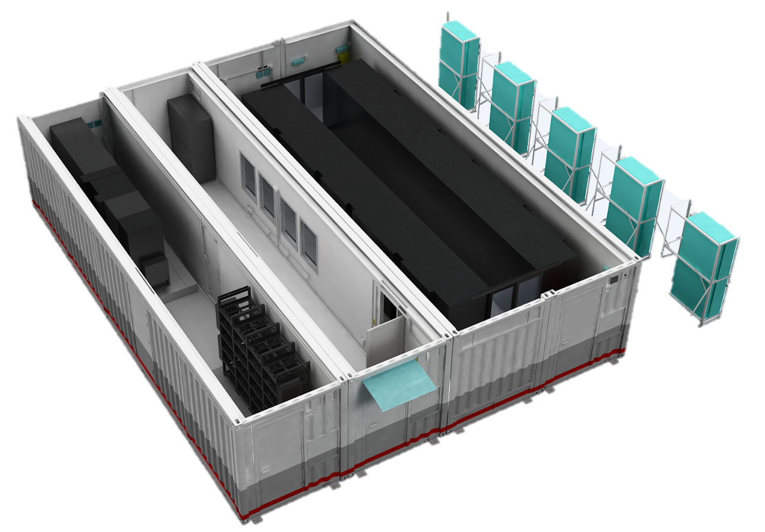
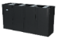
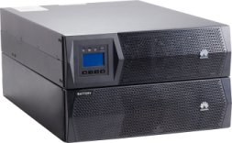
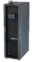
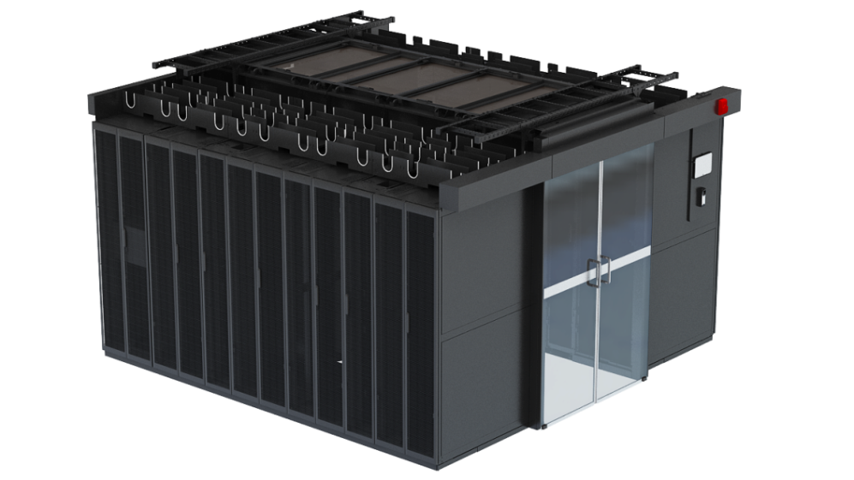
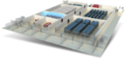
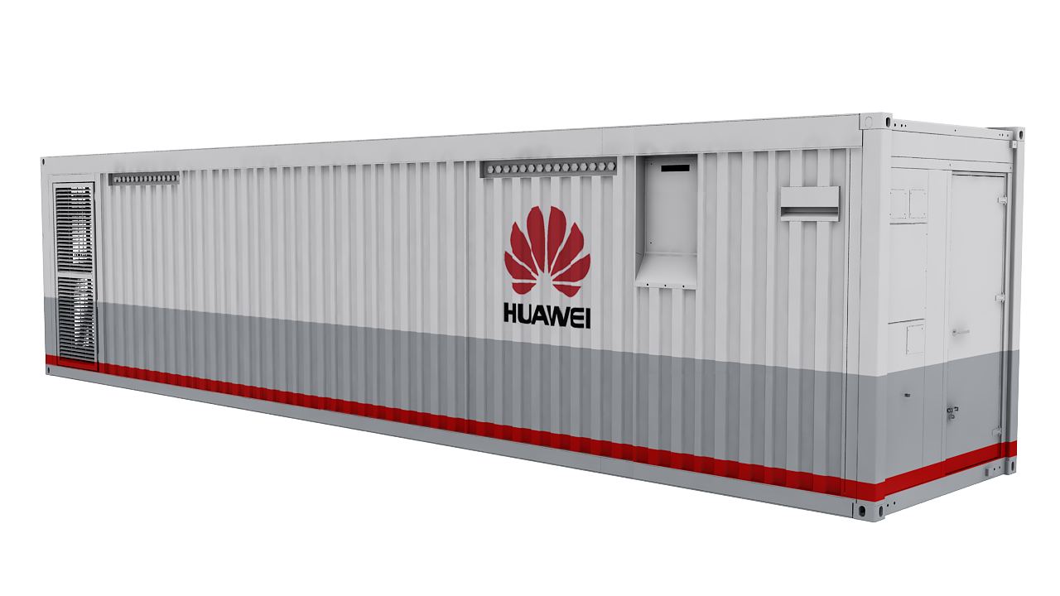
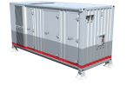
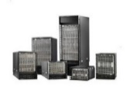
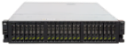
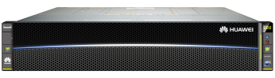
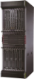
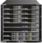

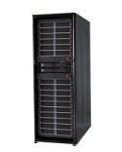
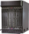
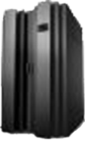
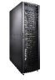
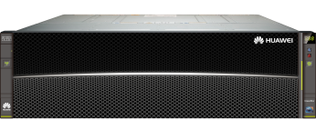
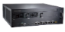
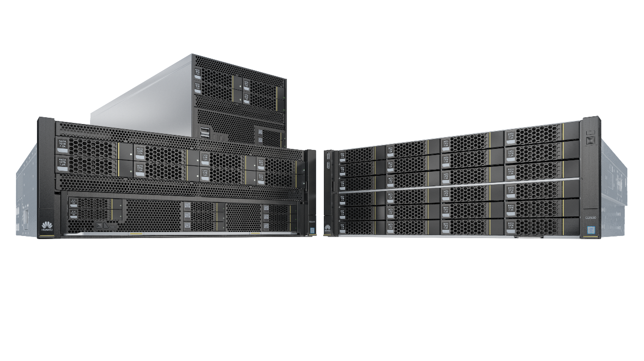
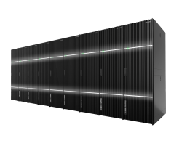
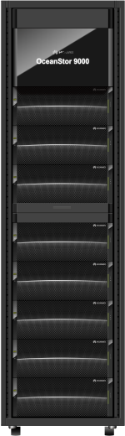
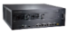
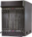

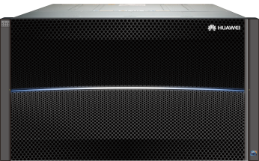
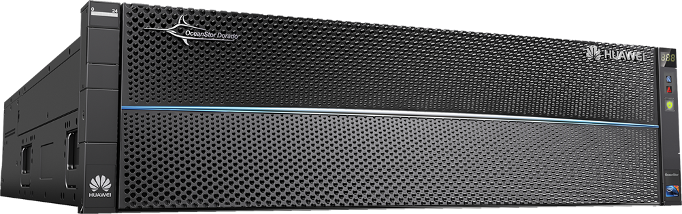
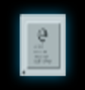

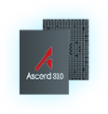
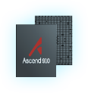
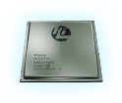
Full-Stack DC solution from Chips to Cloud
General Application
Industry Application
Huawei Hybrid Cloud Solution
R&D Capability:
All Self-developed, Not OEM
Best compatibility and performance, 99.9999% reliability
2) Long-term evolution :
Huawei continuous strategic investment in ICT ,10000+ R&D Engineers, 7 Global R&D centers.
Huawei has rich experience in Telecom Industry, understand Carrier demand
Scenarios:
Private/Public Cloud, VDI, Database, and critical business i.e. CRM, Billing, VAS ,NFV,DB etc;
Edge Cloud
HUAWEI Cloud
HUAWEI Cloud Stack
DC Facility
UPS5000
NetCol8000-A/C
PDU配电柜
UPS2000
Micro-DC
Small Modular DC
Big Modular DC
Small-DC
Big-DC
CloudEngine
ICT Infrastructure
SDSec
X6800
USG9500
Security Controller
5885
FusionServer
5300/5500
CE8860/CE7850 Series
OceanStor
ES3000C
OceanStor DJ
WAF5000
USG9500
CE12800 Series
E9000
5600/5800
NIP6000
SVN5000
CIS
CE6800/CE5800 Series
AntiDDoS8000
8100
KunLun
FusionCube
Dorado
Atlas Series
18000
9000
6800
Chips
SSD
MPI
KUNPENG920
Ascend 910
Ascend 310
Solution Focus on for the material
Notes:
KM:
强大的研发能力，长期演进，保持技术领先，不是混搭组装设备
丰富的运营商市场经营，最了解运营商诉求
覆盖全网的本地端到端服务能力，保障快速响应

Slide 10
Company Overview
Project Scope and Huawei Understanding
Huawei Technical Solution
Huawei Infrastructure Overview
Server
Storage
HCI&CI
Huawei Infrastructure Service
Notes:
标题
改为Project Scope and Huawei Understanding
Huawei Solution改为What Huawei could do

Slide 11
标书关注的技术领域
内容组织参考：
整体技术要求和SOC 满足度
标书配置要求和华为方案
华为服务器解决方案全景图及适配的场景
硬件架构-
可靠性设计
接口设计 –
环境规格
集成与兼容性- 虚拟化，操作系统，上层应用等
管理 与安全性
长远Roadmap（optional）
标书配置要求和华为方案
Redundancy (可靠性)
Form Factor （硬件）
Cloud （集成及兼容性）
Porfolio （系列）
Hardware （硬件）
Operating System Compatibility （集成及兼容性）
Ethernet Adapter （接口）
IO modules （接口）
Power modules （硬件）
Chassis Management Module （硬件）
Environmental Operations （环境规格）
Management （管理）
Support
Warranty

Slide 12
Key Requirement of MTN Infrastructure - Server
No. | Description | Module | Huawei Reply | Reference
Q1 |  |  | FC | Page13-21
Q2 |  |  | FC | page18
Q3 |  |  | FC | page17
Q4 |  |  | FC | Page41-42
Q5 |  |  | FC | page11
Q6 |  |  | FC | Page43-45
Q7 |  |  | FC | page46
Q8 |  |  | FC | Page34-35
Q9 |  |  | FC | Page18-21
Q10 |  |  | FC | Page24-25
Q11 |  |  | FC | Page31-33
Q12 |  |  | FC | Page51
Q13 |  |  | FC | Page50-57
Q14 |  |  | FC | Page54
Q15 |  |  | FC | Page53
Q16 |  |  | FC | Page55-56
Q17 |  |  | FC | Page52
For technical part, there are 5 chapters, total 124 SOCs, and Huawei fully complaint for all of the SOC items.

Slide 13
Storage
Overview
Trend and Product Strategy
Proposed Storage Products
Storage Platform
High System and Data Availability
High Performance
Unified Management
Comprehensive Security
Open Ecosystem
Notes:
标题
改为Project Scope and Huawei Understanding
Huawei Solution改为What Huawei could do

Slide 14


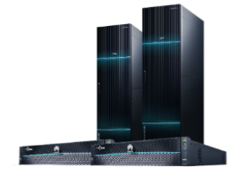

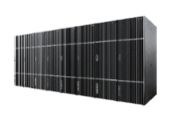
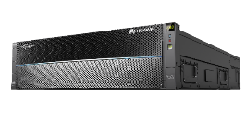

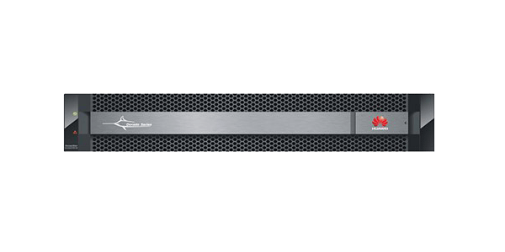
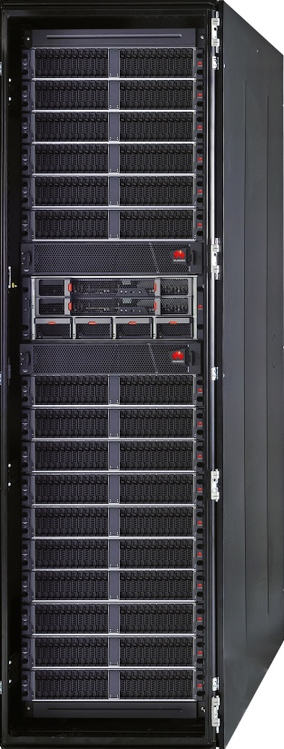
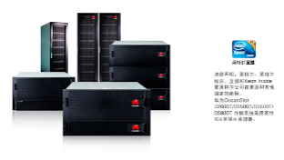
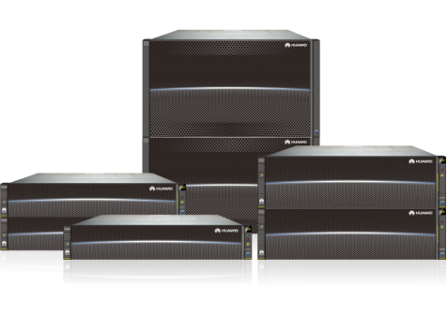
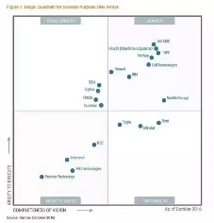
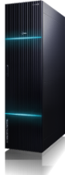

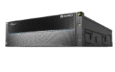
Fast Growing Huawei Storage
Overview | Trend and Product Strategy | Proposed Storage Products | Storage Platform | High System and Data Availability | High Performance | Unified Management | Comprehensive Security | Open Ecosystem
2017
2019
2015
Industry-leading
performance
2013
2nd high-end Storage
AI powered
2011
OceanStor Dorado
2008
1st high-end storage
2002
2006
First batch SSD for
all-flash storage
Recommend class
Interop Prize
2nd FC SAN
Huawei-Symantec
Start
Storage R&D
IP SAN
Start
Grow
Lead
FC SAN
Storage Virtualization product
2003
Scale-out NAS
OceanStor V3
2007
Unified Storage
2009
Unified
SAN & NAS
2012
Named a Leader in Gartner MQ
First full NVMe series
2014
2016
2018
Notes:
2003 发布第一代光纤存储
2006 发布第一代自研IP SAN
2007 发布自研FC SAN-S5000
2008 发布云存储节点T3000
2009 发布第一代分布式NAS
2011 首款全固态存储Dorado2100
2012 发布T系列统一存储

Slide 15
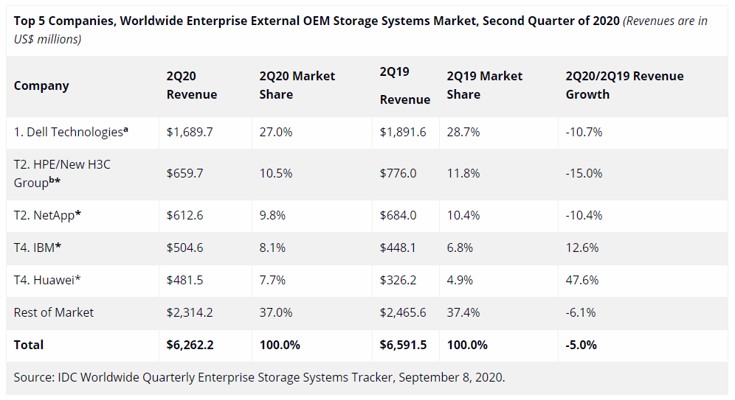
Huawei Storage Rank No.1 in Growth Rate
Overview | Trend and Product Strategy | Proposed Storage Products | Storage Platform | High System and Data Availability | High Performance | Unified Management | Comprehensive Security | Open Ecosystem
No.1
worldwide revenue growth rate
Challengers
Leaders
Ability to execute
Leader
Niche
players
Visionaries
Completeness of Vision
Leader in Gartner MQ for
Primary storage 2019
2019 Vendor Growth rate
Source: IDC Enterprise storage system Tracker 2020Q2
Source: Gartner ECB Market Share Report 2019Q4

Slide 16

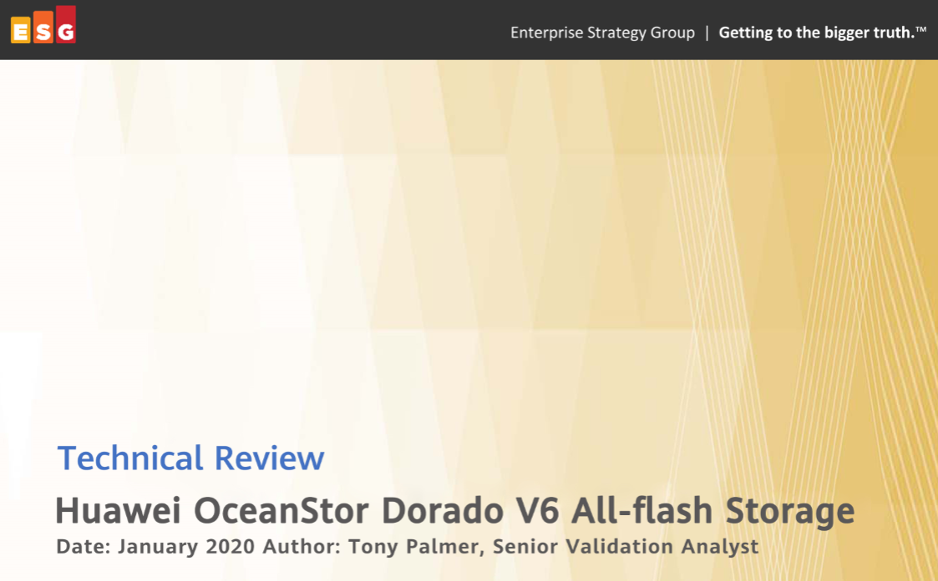
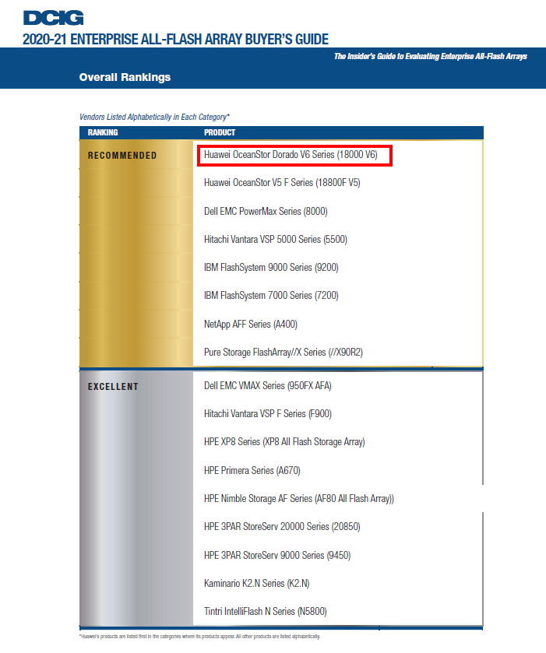
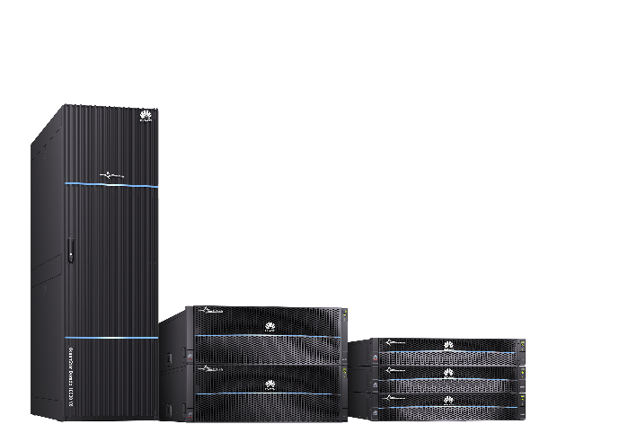




Huawei Storage Gains Industry Renown
Overview | Trend and Product Strategy | Proposed Storage Products | Storage Platform | High System and Data Availability | High Performance | Unified Management | Comprehensive Security | Open Ecosystem
Interop Grand Prize
The Server & Storage category
Verification by the ESG Lab
Easily handles heavy-load enterprise apps
Recommended by DCIG
Listed in Top 5 High-end Storage Array List
A major event in global business technology that recognizes the most competitive products
A well-known IT consulting organization that is renowned for its independent, rigorous, and practical laboratory tests
A global IT consulting organization known for extensive analysis and objective reviews in enterprise storage and cloud computing
Notes:
Our technical capabilities have also been widely recognized in the storage industry.
Interop recognized OceanStor Dorado as one of the most competitive products in the storage field.
ESG lab has verified our storage system's active-active capabilities, minimized latency, tolerance of failures of three SSDs, and deduplication and compression ratios.
Our storage reliability has passed the resistance test for a magnitude-9.0 earthquake. The certification has been especially important in regions such as Argentina and Peru in Latin America.
Why is earthquake reliability such an important feature of OceanStor Dorado? A KPN equipment room in the Netherlands used devices from multiple vendors. One day vibration alarms went off and affected the stability of the devices. In fact, the vibrations caused disk faults and knocked a large number of services offline. But the devices with OceanStor Dorado not only survived the vibrations, but continued running stably without problems. Unlike the products of other vendors, OceanStor Dorado provides stability when you need it the most.

Slide 17


















Vision: Cloud enabled All-flash and Distributed Storage
Overview | Trend and Product Strategy | Proposed Storage Products | Storage Platform | High System and Data Availability | High Performance | Unified Management | Comprehensive Security | Open Ecosystem
Converged :
Centralized storage pool deploy across multiple Data Centers, hybrid storages, protocols, and workloads.
Intelligent :
AI: device, data center, and cloud AI technologies enable data full-lifecycle automation, analytics and optimization.
Open:
Offers consistent experience across multiple cloud and storage vendors.
AS is
To be
Enterprise Workloads
Cloud Native Workloads
Enterprise Workloads
Cloud Native Workloads
kubernetes
kubernetes
SAN
NAS
AFA
Scale-Out Block
Scale-Out NAS
Object Storage
OceanStor
all-flash
OceanStor
distributed storage

Slide 18







Proposed All-Flash and Hybrid Storage
Overview | Trend and Product Strategy | Proposed Storage Products | Storage Platform | High System and Data Availability | High Performance | Unified Management | Comprehensive Security | Open Ecosystem
OceanStor Dorado 8000 V6
OceanStor Dorado 5000 V6
All-Flash
OceanStor Dorado 5000 V6
High-end
OceanStor Dorado 3000 V6
Mid-range
OceanStor 6800 V5
Performance
Entry-Level
OceanStor 5500 V5
Hybrid
OceanStor 5300 V5
High-end
OceanStor 2600 V5
Mid-range
Entry-Level
Scalability
Notes:
OceanStor V5 series is the latest generation of Huawei hybrid flash storage systems that is customized for excellent data services for enterprise-class applications. Here we have the OceanStor V5 portfolio and its major specifications.
Please note that the information on this slide is for reference only. If you want to know more about Huawei all flash storage, refer to the Huawei OceanStor Dorado V6 All-Flash Storage Systems Technical Deep Dive. Now, let's continue our discussion on the V5 series.

Slide 19




Proposed Object and File Storage
Overview | Trend and Product Strategy | Proposed Storage Products | Storage Platform | High System and Data Availability | High Performance | Unified Management | Comprehensive Security | Open Ecosystem
OceanStor 100D
5 Scenarios
Big Data
Object Pool
HPC
Video Cloud
Efficient
Virtualization/Cloud
File
HDFS
Object
Block
Economical
4 Storage
Services
Everlasting
Dedicated
Hardware
OceanStor
OceanStor
All-Flash
OceanStor
Performance
Capacity
Notes:
讲解要点：
今年，面向海量数据场景我们推出了OceanStor存储Pacific系列：
1、硬件层面：我们打造面向不同应用场景的专属硬件，匹配用户的多样化需求，实现硬件领先
2、软件层面：提供块、对象、大数据及文件四种存储协议，通过一套架构满足多样性数据的存储要求
3、方案层面：面向不同场景、不同行业的五大水平，实现产品与解决方案领先
我们希望基于华为在硬件、软件、方案等方面的积累构筑全栈的能力，打造更高效、更经济和更可靠的海量存储，成为海量数据的安心之选。

Slide 20
Fully Compliant to RFP Requirements
Overview | Trend and Product Strategy | Proposed Storage Products | Storage Platform | High System and Data Availability | High Performance | Unified Management | Comprehensive Security | Open Ecosystem
Features | Requirements | Compliance (FC/PC/NC/Title) | All Flash OceanStor Dorado | Hybrid OceanStor V5 | File/Object OceanStor 100D
Redundancy | • High Reliability, availability, and serviceability (RAS) design | FC | ● | ● | ●
 | • System architectures availability must be 99.99% at least | FC | ● | ● | ●
 | • All potential single points of failure are to be eliminated. | FC | ● | ● | ●
 | • Ability to upgrade component independently | FC | ● | ● | ●
 | • High-availability clustering with data mirroring | FC | ● | ● | ●
 | • Ability to test and verify HA mirror without disruption to operations | FC | ● | ● | ●
Compression Support | Should support Compression should be supported in line as data is written, and offline post data ingest | FC | ● | ● | ●
IO Module | • Minimum: 4X 10GbE BaseT including SFP+ | FC | ● | ● | ●
 | • Minimum: 4X 16/32GB FC | FC | ● | ● | N/A
Deduplication support | Should support Deduplication should be supported in line as data is written, and offline post data ingest | FC | ● | ● | ●
Caching support | Support of non-volatile Cache should be supported | FC | ● | ● | ●
Data Tiering | The solution should support data Tiering | FC | N/A | ● | ●
Archiving | The solution should support Archiving | FC | ● | ● | ●
Thin Provisioning | Thin provisioning should be supported | FC | ● | ● | ●
OS support | The following OS should be supported, Windows, RHEL, SLES, Solaris X86, Ubuntu, OLS | FC | ● | ● | ●
Hypervisor | Systems system support advanced hypervisor functionality such as VMware VVOLs, or Hyper-V? Does it add management functionality? | FC | ● | ● | ●
Notes:
讲解要点：
今年，面向海量数据场景我们推出了OceanStor存储Pacific系列：
1、硬件层面：我们打造面向不同应用场景的专属硬件，匹配用户的多样化需求，实现硬件领先
2、软件层面：提供块、对象、大数据及文件四种存储协议，通过一套架构满足多样性数据的存储要求
3、方案层面：面向不同场景、不同行业的五大水平，实现产品与解决方案领先
我们希望基于华为在硬件、软件、方案等方面的积累构筑全栈的能力，打造更高效、更经济和更可靠的海量存储，成为海量数据的安心之选。

Slide 21
Fully Compliant to RFP Requirements (cont.)
Overview | Trend and Product Strategy | Proposed Storage Products | Storage Platform | High System and Data Availability | High Performance | Unified Management | Comprehensive Security | Open Ecosystem
Features | Requirements | Compliance (FC/PC/NC/Title) | All Flash OceanStor Dorado | Hybrid OceanStor V5 | File/Object OceanStor 100D
Third party Support | The vendors will be expected to list a 3rd party back ISV that can use the solution as a backup target, or PaaS offering certified to run on the system | FC | ● | ● | ●
Management | The solution should provide a Storage Resource Management layer, a management GUI, and CLI/API support | FC | ● | ● | ●
Reporting | The system should be able to report overall health status of the system | FC | ● | ● | ●
Automation and templates | The system should have the capability to create templates and ability to script tasks | FC | ● | ● | ●
Public Cloud integration | The solution should support Public Cloud integration capabilities through a CMP layer. | FC | ● | ● | ●
API support | Solution should support REST API and VMware Virtual volumes | FC | ● | ● | ●
Container integration | Solution should support native container integration of container platforms such as Docker etc. | FC | ● | ● | ●
Multiprotocol support | The storage solution should support Fibre Channel, Fibre Channel over Internet (FCoE), ISCSI, NFS and SMB protocols | FC | ● | ● | ●
Upgrades | The system should support non disruptive maintenance. The disks should be removable from Cluster with no service disruption. | FC | ● | ● | ●
Replications | The system should support Active-Active clustering, Asynchronous and asynchronous replication in 2-site and multisite deployments. | FC | ● | ● | ●
Data Protection | The solution should have the capability to Protect data | FC | ● | ● | ●
Scalability | The solution should be scalable by addition of nodes | FC | ● | ● | ●
Security | The solution should have some kind of access control, MFA, security audit logs | FC | ● | ● | ●
LDAP integration | The system should be able to integrate to third party management tools (such as LDAP/Microsoft AD) | FC | ● | ● | ●
Encryption | The system should support encryption | FC | ● | ● | ●
Private Cloud integration | Supports a self-service user portal, and creation of service catalogue by administrators | FC | ● | ● | ●
Power Modules | • Power supplies should support N+N as well as N+1 redundancy configuration, where N is greater than 1. | FC | ● | ● | ●
Notes:
讲解要点：
今年，面向海量数据场景我们推出了OceanStor存储Pacific系列：
1、硬件层面：我们打造面向不同应用场景的专属硬件，匹配用户的多样化需求，实现硬件领先
2、软件层面：提供块、对象、大数据及文件四种存储协议，通过一套架构满足多样性数据的存储要求
3、方案层面：面向不同场景、不同行业的五大水平，实现产品与解决方案领先
我们希望基于华为在硬件、软件、方案等方面的积累构筑全栈的能力，打造更高效、更经济和更可靠的海量存储，成为海量数据的安心之选。

Slide 22







Next-Generation Storage Platform
Overview | Trend and Product Strategy | Proposed Storage Products | Storage Platform | High System and Data Availability | High Performance | Unified Management | Comprehensive Security | Open Ecosystem
Front panel
Rear panel
Controller Enclosures
High-end
4 U, 4 controllers per controller enclosure
4 U, 28 interface modules
Mid-range
2 U, 2 controllers per controller enclosure, 12 interface modules
2 U, 36 NVMe SSDs (high density)
Entry-level
2 U, 2 controllers per controller enclosure, 6 interface modules
Smart SSD enclosure
2 U, 25 SAS SSDs
https://support-it.huawei.com/storage-3D/res/storage/dorado_8000v6_control/index.html?lang=en
Notes:
Our storage series uses an innovative hardware platform with high-density designs for controllers and SSD enclosures.
High-end storage models use 4 U independent controller enclosures. Each supports a maximum of 28 interface modules. Mirroring in controller enclosures and interconnection across those enclosures are implemented through 100 gigabit-per-second RDMA ports.
Mid-range storage models use 2 U controller enclosures with controller and SSD integration. Each enclosure supports a maximum of 12 interface modules. The controllers are mirrored with 100 gigabit-per-second RDMA ports within each enclosure. Two controller enclosures communicate with interconnected 25 gigabit-per-second RDMA ports.
Entry-level storage models also use 2 U controller enclosures with controller and SSD integration. Each enclosure supports a maximum of 6 interface modules. The controllers are mirrored with 40 gigabit-per-second RDMA ports within each enclosure. They use the same RDMA ports as mid-range models for communication.
A common SSD enclosure houses 25 SAS SSDs. A smart SSD has that capability but with the additional option of being able to house 36 NVMe SSDs.

Slide 23



Ever Solid: Five Layers for Extreme Reliability
Overview | Trend and Product Strategy | Proposed Storage Products | Storage Platform | High System and Data Availability | High Performance | Unified Management | Comprehensive Security | Open Ecosystem
Cloud backup
Gateway-free cloud backup
30x higher backup frequency
20x faster backup speed
99.9999%
system-level reliability
Solution
Gateway-free active-active solution (1 ms latency)
FlashEver without data migration
System
Comprehensive enterprise-class features
Tolerance for simultaneous failures of 3 disks
Reconstruction of 1 TB data in 15 minutes
99.99999%
solution-level reliability
Architecture
Tolerance for failures of 7 out of 8 controllers with SmartMatrix fully-interconnected architecture
E2E active-active design
SSD
Global wear leveling
Huawei-patented global anti-wear leveling
35
Notes:
Our next-gen OceanStor Dorado V6 provides five layers of reliability. It does so with disk-level reliability hardening, industry-leading architecture, system-level RAID virtualization, tolerance of three-disk failures, solution-level gateway-free active-active design, and cloud-level online and offline backup integration.
It provides six-nine system-level and seven-nine solution-level protection for customer data.

Slide 24

Industry-Leading Disk Reliability by 6 Core SSD Technologies
Overview | Trend and Product Strategy | Proposed Storage Products | Storage Platform | High System and Data Availability | High Performance | Unified Management | Comprehensive Security | Open Ecosystem
SSD wear leveling and Huawei-patented anti-wear leveling
LDPC + SmartFSP 3.0 for error correction granularity 10x superior to competitors
Intra-disk DIF preventing silent data corruption
Data inspection algorithm preventing data distortion
Built-in dynamic RAID improving utilization
RAID at the SSD and system levels
Notes:
Disk reliability is the foundation of storage. Huawei has made tremendous strides in research on improving disk reliability to develop our own SSDs. We use wear leveling and anti-wear leveling to extend SSD lifespans and LDPC and SmartFSP 3.0 for improved correction of granularity errors. Our intra-disk DIF prevents silent data corruption and our data inspection algorithm prevents data distortion. We have adopted built-in dynamic RAID to improve space utilization and RAID at the SSD and system levels for data recovery. All of these improvements have had the same goal: better reliability for every disk. Let's take a closer look at each of these technologies.

Slide 25


Architecture Reliability — SmartMatrix Sets a New Benchmark
Overview | Trend and Product Strategy | Proposed Storage Products | Storage Platform | High System and Data Availability | High Performance | Unified Management | Comprehensive Security | Open Ecosystem
Host I/Os
Network adapter
Network adapter
One FIM shared by 4 controllers
A FIM connects to 4 controllers through PCIe ports to access all the controllers in active-active mode using multi-channel technology.
FIM
FIM
FIM
FIM
192 cores
192 cores
Fully interconnected controllers
Shared Back-End
Shared Back-End
The controllers in an enclosure are fully interconnected through a passive backplane.
Cross-enclosure expansion: 100 Gbit/s RDMA shared interface modules connect to 8, 12, or 16 controllers.
BIM
BIM
BIM
BIM
192 cores
192 cores
2 controller enclosures connected to 1 smart SSD enclosure
A BIM is installed in a controller enclosure. All controllers can simultaneously access an SSD enclosure connected to the BIM.
A smart SSD enclosure has 2 groups of uplink ports that connect to 2 controller enclosures. The SSD enclosure connects to 8 controllers.
Notes:
Let's turn to architecture reliability. The SmartMatrix architecture of OceanStor Dorado V6 implements global interconnection and load balancing through front-end sharing and interconnection, full controller interconnection, and back-end sharing and interconnection.
As you can see on the table to the right, Huawei OceanStor Dorado V6 can tolerate failure of seven out of eight controllers. This is the best reliability in the industry.

Slide 26
Architecture Reliability — Industry-Leading Service Continuity
Overview | Trend and Product Strategy | Proposed Storage Products | Storage Platform | High System and Data Availability | High Performance | Unified Management | Comprehensive Security | Open Ecosystem
Vendor E
2 controllers, scale-out
Vendor H
4 to 8 controllers, scale-out
OceanStor Dorado
I/O interface module connected to 1 controller
Controller failure: front-end link switching
Interface module shared by controllers
Controller failure: 0 front-end link switching
Interface module shared by controllers
Controller failure: 0 front-end link switching, 0 impact on hosts
Front end
Controllers
Back end
SSD enclosure connected to 2 controllers (1 controller enclosure)
2-controller failure: service disruption
SSD enclosure connected to 4 controllers (1 controller enclosure)
4-controller failure: service disruption
Global cache: continuous mirroring, 3 copies across controller enclosures
SSD enclosure connected to 8 controllers (2 controller enclosures)
Up to 7-controller failure: 0 service disruption
Notes:
This slide compares Huawei with other vendors in architecture reliability. As you can see, Huawei far surpasses every other competitor.
The far left diagram shows vendor E's storage system. Each controller enclosure only has two controllers. On the back end, an SSD enclosure can only connect to one controller enclosure. If a controller enclosure or two controllers in one enclosure fail, services will be interrupted.
The middle diagram shows vendor H's storage system. One controller enclosure has four controllers. Like Vendor E, an SSD enclosure only connects to one controller enclosure. If a controller enclosure or four controllers in one enclosure fail, services will be interrupted.
Finally, we have Huawei OceanStor Dorado. It has full interconnection, three cache copies, and far superior performance.

Slide 27

System Reliability
— Fully Redundant System Architecture for Hot-Swappable Components
Overview | Trend and Product Strategy | Proposed Storage Products | Storage Platform | High System and Data Availability | High Performance | Unified Management | Comprehensive Security | Open Ecosystem
Power module
Management module
Interface module
BBU
System subrack
Controller
Fan module
Notes:
OceanStor Dorado V6 adopts a fully redundant design for all of its components. Each component is hot-swappable to protect service continuity.
The controller and management modules have redundancy protection from at least two backups. Consumables like the power module or fan module have even more backups.

Slide 28


System Reliability— RAID-TP Provides Customized Protection for SSDs
Overview | Trend and Product Strategy | Proposed Storage Products | Storage Platform | High System and Data Availability | High Performance | Unified Management | Comprehensive Security | Open Ecosystem
Large-capacity SSDs lead to double the capacity (up to 32 TB) and 5x to 10x the failure rate
15 minutes
Simultaneous 3-disk failure without service interruption
RAID-TP
5 hours
Traditional RAID
Reconstruction of 1 TB data
SSD failure toleration
Traditional RAID: up to 2 SSDs
Huawei RAID-TP: simultaneous 3-SSD failure
Data reconstruction
Traditional RAID: 5 hours
RAID-TP: 1 TB of data within 15 minutes
Notes:
Large-capacity disks make disk failure more dangerous than ever before. But Huawei's RAID-TP and RAID 2.0+ can help protect you.
RAID-TP uses an innovative parity algorithm to tolerate the collective failure of three disks without affecting services.
A RAID algorithm generally provides redundancy protection by forming RAID groups with disks. LUN space can only come from one RAID group. Data is reconstructed at the RAID layer in case of disk failure. That's why solutions from EMC and HDS take so long to reconstruct data. However, our in-house RAID 2.0+ algorithm distributes hot spare space to all disks. If a disk fails, every disk participates in data reconstruction to shorten the time required by larger-capacity disks. RAID 2.0+ shortens the per-terabyte data reconstruction from five hours to just fifteen minutes.

Slide 29

System Reliability— Comprehensive Enterprise-Grade Features
Overview | Trend and Product Strategy | Proposed Storage Products | Storage Platform | High System and Data Availability | High Performance | Unified Management | Comprehensive Security | Open Ecosystem
Periodic snapshots within 3 seconds
Snapshot consistency group
Hybrid cascaded snapshot and clone
Multiple disk domains or dual controllers
Cross-domain clone
Wide range of enterprise-grade features
Enhanced hardware and software reliability
LUN copy
Protection consistency group
Forward and reverse incremental copy
DR star networking
Cloud backup
Notes:
OceanStor Dorado V6 provides a complete package of enterprise features for more reliable storage.
These features include three-second periodic snapshots, snapshot consistency groups, and hybrid cascaded snapshots and clones. Let's briefly go over each one.

Slide 30
System Reliability
— ROW and Multi-Time-Point Tech for Snapshots
Overview | Trend and Product Strategy | Proposed Storage Products | Storage Platform | High System and Data Availability | High Performance | Unified Management | Comprehensive Security | Open Ecosystem
Read-only snapshot clone
1.
Source
1. Creates clone with read-only snapshot
Clone creation with HyperCDP
HyperClone_1
Unlimited snapshot rollback
TP0
HyperCDP_0
2.
HyperClone_2
Point-in-time tech for cross-level snapshot rollback
TP1
HyperSnap_0
3.
Hybrid cascaded snapshot and clone
TP0
HyperSnap_1
2. Cross-level rollback
TP1
Point-in-time redirection for cascaded snapshot and clone
TP2
TP0
HyperSnap_2
TP2
TP1
3. Cascaded snapshot
HyperClone_3
TP2
3. Cascaded clone
TP0
HyperSnap_3
TP1
HyperClone_3
Snapshots with perfect performance using ROW and multi-time-point technologies
Only pointers modified
No need to copy original data
0 performance loss
Data availability anytime, anywhere
Snapshot interval in seconds
Cross-level rollback
Cascaded
snapshot/clone
Writable snapshot
Notes:
Traditional HDD storage arrays use the COW mechanism because it takes advantage of their sequential read capability. However, COW is now inadequate due to the widespread use of SSDs, which have made random reads more common. Huawei has redesigned their storage software system with ROW to overcome this problem. OceanStor Dorado V6 supports read-only snapshot clones, snapshot rollback to any time point, and hybrid cascaded snapshots and clones.

Slide 31

System Reliability
— Stable Performance with Snapshot Enabled
Overview | Trend and Product Strategy | Proposed Storage Products | Storage Platform | High System and Data Availability | High Performance | Unified Management | Comprehensive Security | Open Ecosystem
Snapshot applications: development, testing, analytics
Stable performance when continuously activating snapshots
Development (40 TB)
Testing (40 TB)
Analysis (80 TB)
Performance
OceanStor Dorado
Servers
Multi-copy technology
Traditional storage
Production (10 TB)
Storage
Snapshot-based
Development (4 TB)
Testing (4 TB)
Analysis (8 TB)
Snapshot 1
Snapshot 2
Snapshot 3
Time
Stable performance during:
Snapshot activation
Continuous snapshotting (interval: seconds)
The whole lifecycle
Avoids multiple copies to improve space utilization
Copies less data to reduce performance loss
Notes:
Data snapshots are important to development and testing applications. They enable data reuse without copying and prevent performance loss of the production system.
The ROW-based V6 permits snapshot activation without affecting performance.

Slide 32
System Reliability
— Industry-Leading HyperCDP with 3-Second Interval
Overview | Trend and Product Strategy | Proposed Storage Products | Storage Platform | High System and Data Availability | High Performance | Unified Management | Comprehensive Security | Open Ecosystem
3-second interval
LUN
TP
TP+1
TP+2
…
TP+N
CDP snapshots
CDP 0
CDP 1
CDP 2
…
CDP N
(Max = 60,000)
Snapshot copy creation
Rollback
Snapshot copy
Snapshot copy
Periodic policies with shortest interval
More intensive and persistent data protection
HyperCDP schedules by day, week, month, or specific interval for customized backup.
The multi-time-point and ROW technologies create a data copy (at a certain point in time) of a source LUN at a minimum interval of 3 seconds.
Each CDP snapshot matches a time point of the source LUN.
HyperCDP only saves the corresponding time points, surpassing common snapshots with stronger and longer protection.
A single LUN supports up to 60,000 HyperCDP snapshots. The minimum snapshot interval is 3 seconds, providing continuous protection for three days.
Notes:
Previous storage systems provided writable snapshots. A single LUN supported up to 1,000 snapshots, and the shortest snapshot interval was 30 seconds. However, these specifications provided inadequate data protection for mission-critical applications. This urgent need for snapshot technologies with higher density led to the creation of HyperCDP. It is a high-density snapshot technology of Huawei all-flash storage which provides continuous data protection. HyperCDP uses lossless snapshot technology to preserve the performance of source LUNs. Unlike writable snapshots, HyperCDP does not need to build LUN objects, greatly reducing memory overhead and providing stronger and continuous protection.

Slide 33
Solution Reliability
— Gateway-Free Active-Active Cross Data Center Solution
Overview | Trend and Product Strategy | Proposed Storage Products | Storage Platform | High System and Data Availability | High Performance | Unified Management | Comprehensive Security | Open Ecosystem
Lightning-fast and rock-solid
ERP
CRM
BI
Gateway-free
Fewer nodes and simplified management
Active-Active
load balancing between sites, RPO = 0, RTO ≈ 0
OceanStor Dorado
OceanStor Dorado
HyperMetro
Gateway-free active-active
Production center A
Production center B
HyperReplication
HyperReplication
Easy-to-scale
OceanStor storage system
Scalability to 3DC improves reliability.
Serial, parallel, and star networking meets the most demanding requirements for enterprise reliability.
Interconnection with traditional storage builds cost-effective disaster recovery systems.
OceanStor Dorado
DR center
Notes:
Now, let's move to solution reliability. OceanStor Dorado V6 meets the most demanding requirements of enterprises and uses a gateway-free active-active solution for high reliability. But how exactly does it work?
Firstly, the active-active architecture uses two storage arrays to form a cross-site cluster system without additional devices for virtual gateways for a faster I/O response. Latency and possible fault points caused by gateway forwarding are reduced because I/Os are not forwarded by gateways.
Secondly, active-active LUNs are implemented. Data on two LUNs from two storage arrays is synchronized in real time, and hosts can read and write LUNs at both ends. If one storage array fails, the host will switch to the other for continuous service access.
Thirdly, various 3DC, or 3 data center, networking modes are available. HyperMetro and asynchronous replication form a 3DC mode, supporting serial, parallel, or DR star networking.
Finally, HyperMetro is supported between OceanStor Dorado V6 storage for a cost-effective DR system.

Slide 34



Solution Reliability
— FlashEver Ensures Zero Data Migration for Always-On Services
Overview | Trend and Product Strategy | Proposed Storage Products | Storage Platform | High System and Data Availability | High Performance | Unified Management | Comprehensive Security | Open Ecosystem
New upgrade model
Individual replacement of controllers or SSD enclosures instead of replacing the entire system
Zero data migration and zero service disruption
Free access to next-gen hardware for a 20% performance increase
OceanStor Dorado Vx
OceanStor Dorado Vx+1
OceanStor Dorado Vx+2
Notes:
Finally, based on the five-layer reliability design, FlashEver simplifies upgrades with individual device replacement. Because there is no need to replace the whole system, data migration becomes unnecessary. Customers just replace individual controllers or disk enclosures for zero data migration and zero service interruption.
In addition, the next-generation software and hardware improve the performance by at least 20% compared with the previous generation.

Slide 35
Solution Reliability
—Seamless Service Migration to New-Gen Hardware
Overview | Trend and Product Strategy | Proposed Storage Products | Storage Platform | High System and Data Availability | High Performance | Unified Management | Comprehensive Security | Open Ecosystem
Storage controller upgrade
SSD enclosure upgrade
Data in place (DIP) upgrade for zero service interruption or data migration
SSD enclosure replacement without service interruption
Legacy controller enclosure
Legacy controller enclosure
Step 1
Remove an existing controller and install a new controller.
Legacy SSD enclosure
New SSD enclosure
New controller
Heterogeneous virtualization and
third-Party storage reuse
I/O
I/O
Switch services to new controllers.
Takeover from third-party storage devices and reuse of the legacy storage system. Services smoothly migrate to OceanStor Dorado devices.
Legacy controller enclosure
.
Step 2
Repeat step 1 to replace all other controllers.
Original path
New path
Takeover path
New controller
Data
Data
Traditional storage
eDevLUN
Target LUN
OceanStor Dorado
Notes:
How does FlashEver work? This slide shows the lengths Huawei has gone to in designing controllers, disk enclosures, controller enclosures, and even third-party storage devices.
As a result, customers can replace controllers across generations because both legacy and new controllers are available online. Disk enclosures can be similarly replaced, as data can be migrated within an array for the reuse of storage devices.
Storage controller upgrades therefore allow for individual controller replacement for zero service interruption or data migration.
SSD enclosures late in their service lives can connect to the new SSD enclosure for seamless data migration.
Customers who want to reuse third-party storage must first use Huawei storage to take over original storage resources like the LUNs. Then eDevLUNs must be created to inherit the WWN of the original LUNs. Finally, internal resources should be allocated so that data migration can be started internally without disrupting services.

Slide 36




Cloud Reliability
— Converged Data Management for the Most Comprehensive DR Solution
Overview | Trend and Product Strategy | Proposed Storage Products | Storage Platform | High System and Data Availability | High Performance | Unified Management | Comprehensive Security | Open Ecosystem
DC 1
DC 2
Cloud DR center
Active-active data protection for uninterrupted data services
Continuous data protection within seconds for zero data loss
No backup software or gateway for less investment
Snapshot copy available immediately for service recovery in minutes
Cloud backup and recovery
Unified cloud management simplifies O&M
Service recovery
Second-level
Minute-level
Hour-level
Zero service downtime, zero data loss
61
Notes:
Now, it's more common to migrate service data on cloud, especially for non-important data. Therefore, people are pursuing for the reliability of cloud.
The DR features of the storage system, such as second-level snapshot, eBackup, and OceanStor DJ, implement converged data management in the DR center and on-cloud center. As a result, the system achieves minute-level reliability and hour-level DR and recovery on and off the cloud for 100% service continuity and zero data loss.

Slide 37



Chip-Powered Platforms for up to 20 Million IOPS
Overview | Trend and Product Strategy | Proposed Storage Products | Storage Platform | High System and Data Availability | High Performance | Unified Management | Comprehensive Security | Open Ecosystem
Chip-powered
Seamless storage upgrades for industry-leading performance
Industry's highest performance
Protocol-leading
E2E NVMe for a high-performance IO expressway
Algorithm-accelerated
SSD-controller synergy with intelligent algorithms for maximized all-flash performance
FlashLink®
Notes:
SPC-1 is a standard model commonly used to measure storage system performance. The SPC-1 benchmark directly reflects the capabilities of storage systems in various scenarios. Many storage vendors, including us, participate in SPC-1 benchmark tests to improve product performance and demonstrate product capabilities. The latest SPC-1 benchmark results show that our OceanStor Dorado V6 high-end storage provides 20 million IOPS and 0.1 millisecond ultra-low latency. This performance is double that of the next-leading competitor.
Our high performance is due to our continuous innovation in chips, protocols, and software algorithms.

Slide 38


No.1 Performance with 5 Intelligent Chips
Overview | Trend and Product Strategy | Proposed Storage Products | Storage Platform | High System and Data Availability | High Performance | Unified Management | Comprehensive Security | Open Ecosystem
Network chip
2x improved network latency
1
Transmission
Kunpeng 920 processor
2x higher performance
2
Compute
Intelligence
AI chip
50% better read hit ratio
3
4
Storage
SSD controller chip
2x improved write latency
5
Management
BMC chip
30% improved fault location
Notes:
First, let's talk about chips. Unlike other vendors, our goal is to provide customers with the ultimate performance experience. We have therefore independently developed five chips for all key I/O paths. They are for transmission, compute, intelligence, storage, and management. They lay the solid foundation on which we have built the industry's fastest storage. Let's take a moment to look at each chip.

Slide 39

Ever Fast: E2E NVMe for all Storage Series
Overview | Trend and Product Strategy | Proposed Storage Products | Storage Platform | High System and Data Availability | High Performance | Unified Management | Comprehensive Security | Open Ecosystem
0.1 ms
Server
HBA
Switch
Test model: 7:3 read/write, 130 μs read latency, 50 μs write latency
Time = 130 x 0.7 + 50 x 0.3 = 106 μs
16 Gbit/s Fibre Channel or 10GE
32 Gbit/s FC-NVMe
NVMe over 100 Gbit/s RDMA
SCSI
INTERPOSER
SAS
Shorter path
Wider channel
Fewer interactions
NVMe
562 μs
106 μs
E2E
Full series
Every model ever fast
NVMe AFA
*Front-end NVMe over 100 Gbit/s RDMA will be available in the next version.
*Deployment of FC NVMe or NVMe over ROCE due to the maturity of ecosystem.
SAS AFA
Notes:
We achieved the first full series of end-to-end NVMe storage products, meaning both our mid-range and mission-critical product models support NVMe.
NVMe provides reliable NVMe commands and data transmission. NVMe over Fabrics can extend NVMe to various storage networks. It reduces overhead in processing storage network protocol stacks and achieves high concurrency and low latency for applications.
You may ask how we calculated the 0.1 millisecond latency. We use a typical database model, a single LUN, and a single concurrency for the test. The read/write ratio is 7 to 3, read latency is 130 microseconds, and write latency is 50 microseconds. So the overall system latency is 106 microseconds.

